Slide 1
EEE 304 Digital Electronics Laboratory Project Update Presentation FSM Based Ticket Vending Machine (TVM) using FPGA
ID:
2006009
2006011
2006018
2006025
Group NO. 04
Section: A1

Slide 2
Outline
Objectives
Introduction
Methodology
State Diagram
Sample Output

Slide 3
Objective
Design a Digital FSM Architecture for a Ticket Vending Machine (TVM)
Implement Ticket Selection Logic
Incorporate Rebate Logic
Generate Output Signals for Ticket Dispensing

Slide 4
Introduction
What is a Ticket Vending Machine?
A Ticket Vending Machine (TVM) is an automated device that issues tickets, typically for public transportation, such as buses, trains, or trams.
This project proposes a FSM based digital logic scheme for a Ticket Vending Machine where passengers can buy tickets with simple operation.

Slide 5
Key components of a TVM
Source and Destination Station Selection
Ticket Number Selection
Rebate System (Discounts)
Payment Option
User Interface
Printing
We will only focus on the digital logic part on this project.

Slide 6
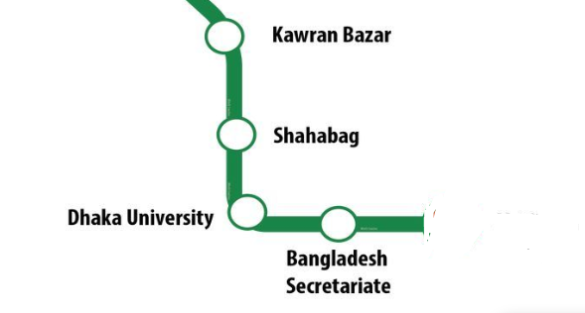
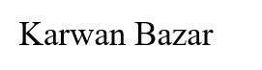
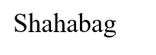
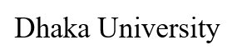

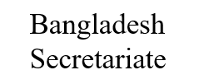
Key Features of the Proposed TVM
Ticket Selection
For Our Project we will design the TVM operating for Five Metro Stations.
Each passenger can get at most two tickets at a time.
According to the selection of station and total number of stations total cost will be calculated.
Mothijheel

Slide 7
Key Features of the Proposed TVM
Rebate System
Students, physically challenged and senior citizens will get a discount of 5 Tk on the cost of each ticket, by providing a code assigned to them.
After they enter the code, the software matches the code with database and if the code matches, that passenger will get a discount

Slide 8
Key Features of the Proposed TVM
Money and Change:
There will be four types of money (5/10/20/50 tk)
If the inserted amount is equal to the cost, then the ticket will be dispensed.
And if the amount is larger, the change is returned with the ticket.
If the amount is smaller, process will continue till input money is greater or equal than cost.

Slide 9
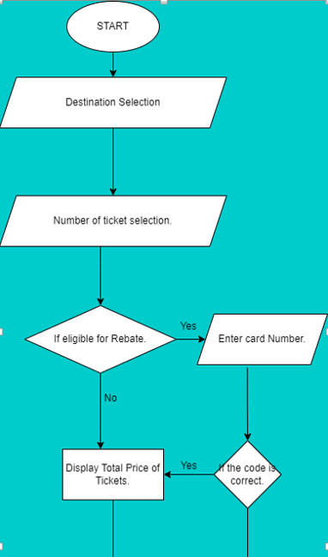
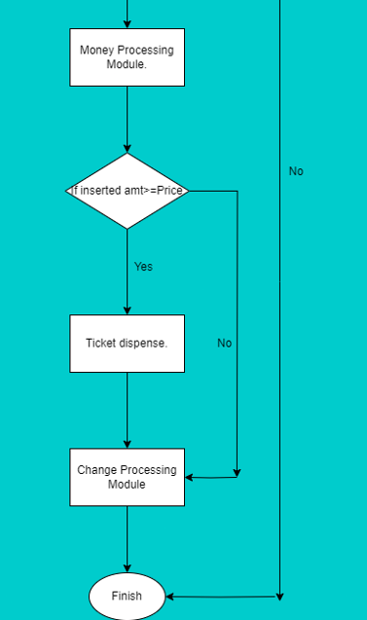
Methodology

Slide 10

Methodology

Slide 12
Methodology
Taking Input
In our CPLD Board we have 8 Input pins. Each Input Pin will be assigned to necessary input variables.
We have four pulse switches which is also assigned necessary Variables.
Also, global clock for 7 Segment Display will be given from inbuild clock from the CPLD board.

Slide 13
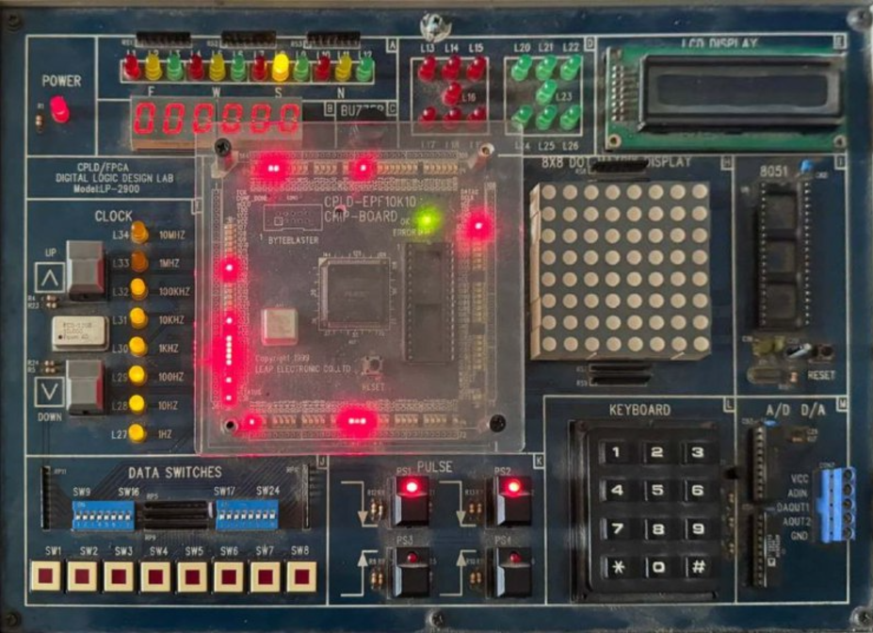
Methodology (Taking Input)
8 Input Pins
(Leveled As SW1 to SW8)
4 Pulse Switches
(PS1 To PS4)

Slide 14
Methodology (Taking Input)
Pin Number | What it Indicates | Interpretation
Pin 1 | A Clock for Changing the State | Acts as a ‘Done’ or ‘Next’ Button in User interface
Pin 2 | Reset | Resets the Machine to IDLE State.
Pin 3,4,5 | Which Station | Motijheel= 3’b 000; Bangladesh Sec. = 3’b 001; Dhaka University= 3’b 010; Shahbagh= 3’b 011; Karwan Bazar= 3’b 100; (Any Other Value will give error)
Pin 6, 7,8 | Money input | 0 taka= 3’b 000; 5 taka = 3’b 001; 10 taka= 3’b 010; 20 taka= 3’b 011; 50 taka= 3’b 100; (Any Other Value will not change the total money)

Slide 15
Methodology (Taking Input)
Pin Number | What it Indicates | Interpretation
PS1, PS2 | Rebate Code | Value of this two pulse acts as rebate code, in our design the correct rebate code is 2’b 11.
PS4 | Rebate Code Validation | Defines a state for taking the rebate code as input 0=rebate code can’t be inputted (rebate code is ignored) 1= rebate code can be inputted (rebate code is checked if it is right or wrong)
PS3 | Number of Passengers | Pulse 0 = 1 Passenger. Pulse 1 = 2 Passengers

Slide 16
Methodology
Showing Output
For the output part we will have,
Cost of the tickets
Total Amount of Input Money
Return Money
Ticket Buy Completed
Error

Slide 17
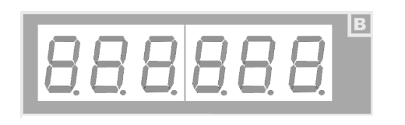
Methodology (Showing Output)
Indicates if the Total Money in exceeds 100 or not
Ticket Buy
Completed
Indicates if the Total cost exceeds 100 or not
Return Amount
Input Money
(Last 2 Digit)
Total Cost
(Last 2 Digit)

Slide 18
State Diagram
If Reset=1 then the machine always comes to ‘IDLE’ State regardless of its current state
Diff_st = abs(source_station – station)
Reset
IDLE
Diff_st = 1/Fare = 7’d0
Anything else/Fare = 7’d0
Diff_st = 2/Fare = 7’d0
Diff_st =4/Fare = 7’d0
Next1
Diff_st = 3/Fare = 7’d0
Error
Next2
Next4
Next3
Fare calculation FSM Block

Slide 19
State Diagram
Input /Output Form
R.C.V=1, Rebate code=11/Fare = 7’d
Error
Next1
Next2
Next3
Next4
Rebate Code
Valid
2 bit Rebate Code
Anything else/Fare = 7’d0
1,11/Fare = 7’d15
0,xxx/ 7’d30
0,xxx/ 7’d40
0,xxx/ 7’d50
1,11/ 7’d25
1,11/ 7’d35
1,11/ 7’d45
0,xxx/7’d20
Next1R
Next2R
Next3R
Next4R
Fare calculation FSM Block

Slide 20
State Diagram
Input /Output Form
Passenger/Fare = 7’d
Next1R
Next2R
Next3R
Next4R
1/Fare = prev_fare<<1
1/Fare = prev_fare<<1
0/Fare = prev_fare
0/Fare = prev_fare
0/Fare = prev_fare
1/Fare = prev_fare<<1
1/Fare = prev_fare<<1
0/Fare = prev_fare
FinalFare
Fare calculation FSM Block

Slide 21
State Diagram
FinalFare
clk/Sum = 0, Change = 0, Vend = 0
ADD
Money_in && Sum<Fare /Sum = Sum + Money_in, Change = 0, Vend = 0
Total Money In Calculation FSM Block

Slide 22
State Diagram
If Reset=1 then the machine always comes to ‘IDLE’ State regardless of its current state
Money_in && Sum<Fare /Sum = Sum + Money_in, Change = 0, Vend = 0
ADD
IDLE
Sum>Fare/Sum =Sum, Change = Sum-Fare, Vend = 1
Done
Reset=1
clk/Sum = Sum, Change = Sum-Fare, Vend = 1
Total Money In Calculation FSM Block

Slide 23
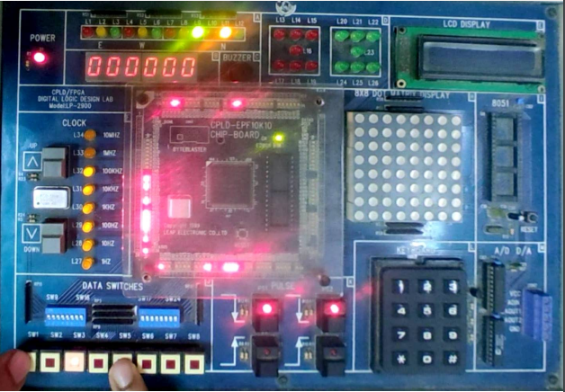
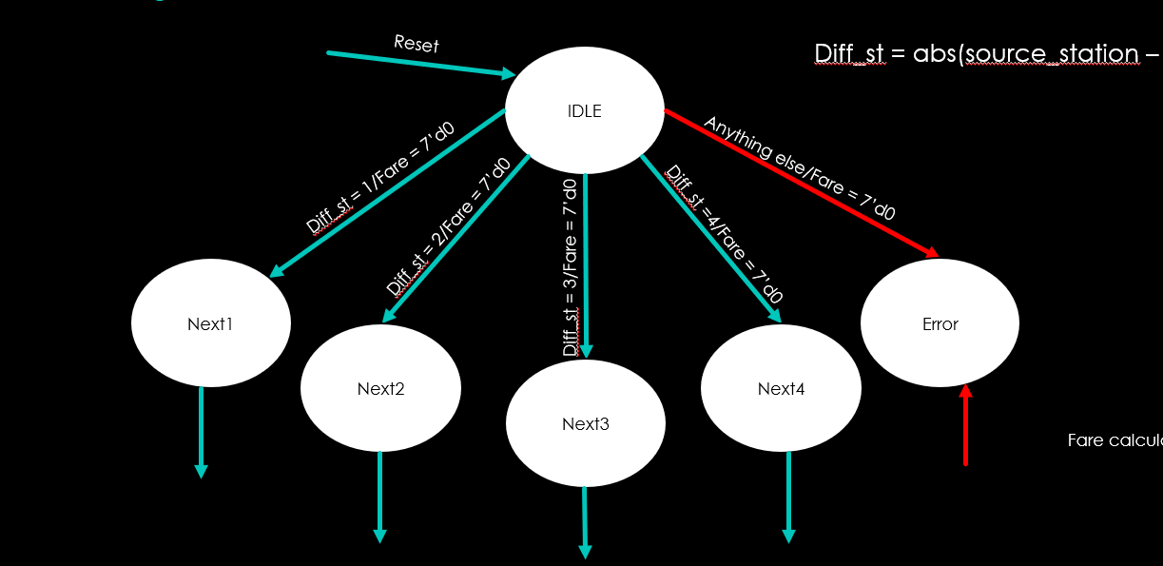
Sample Output
Source : Motijheel
Destination : Karwan Bazar (100)

Slide 24
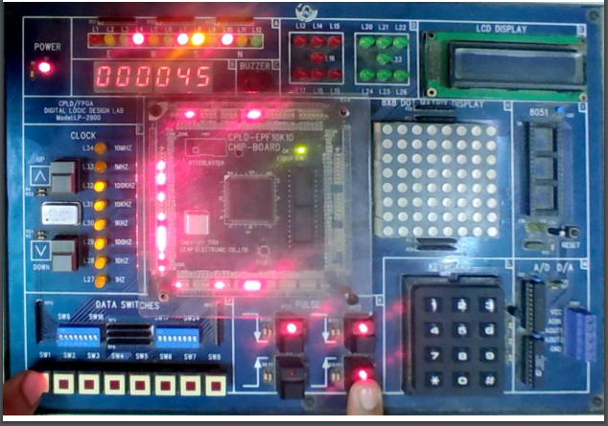
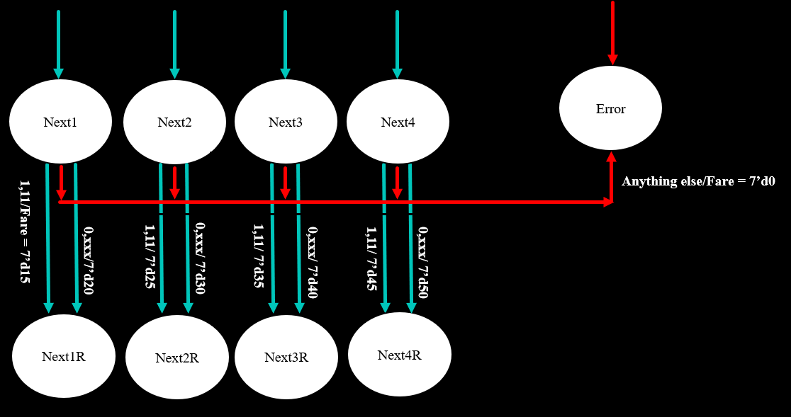
Sample Output
Rebate Code : 11 Fare= 45 Taka
Rebate Code Valid : 1

Slide 25
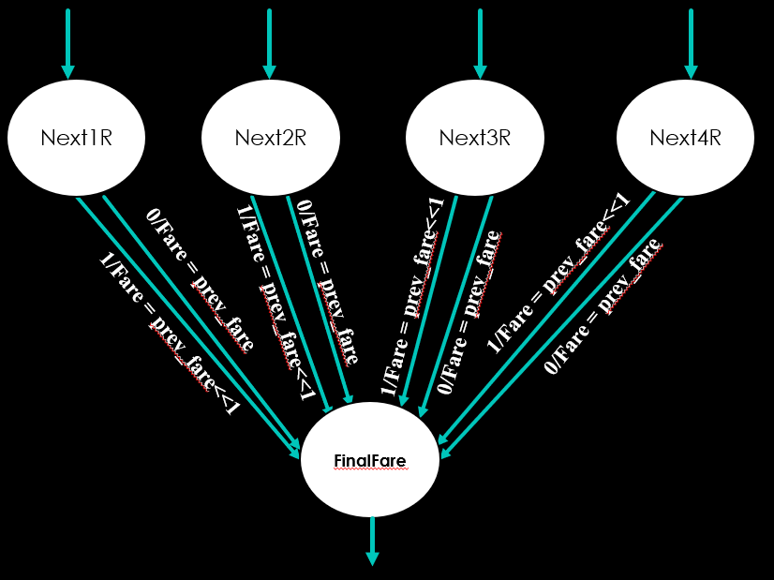
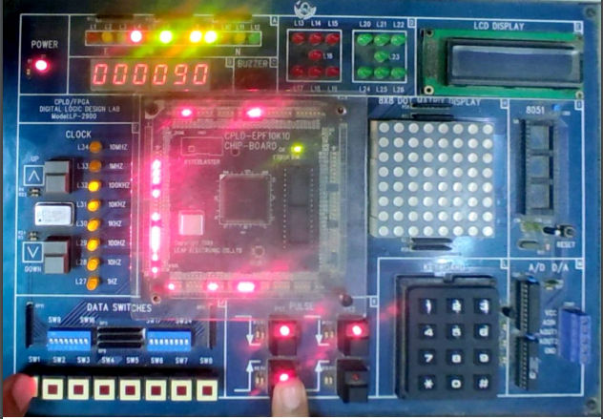
Sample Output
Passenger : 1 Fare= 90 Taka

Slide 26
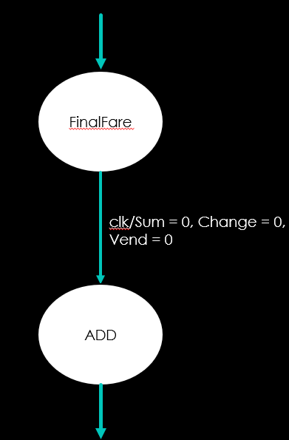
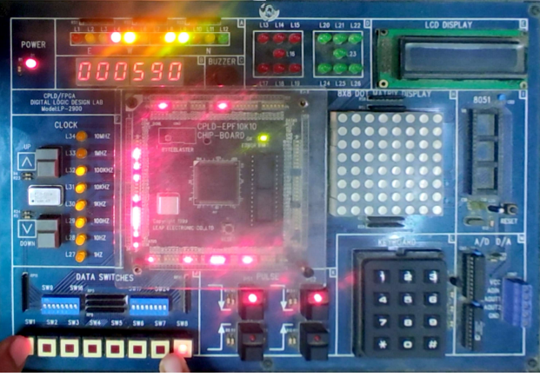
Sample Output
Money In : 001 (5Tk)
Fare : 90 Tk
Money Input : 5 TK

Slide 27
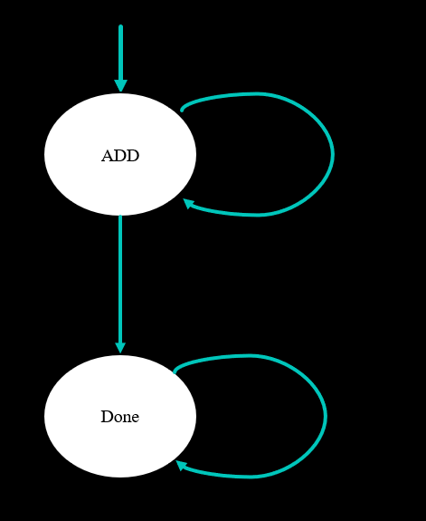
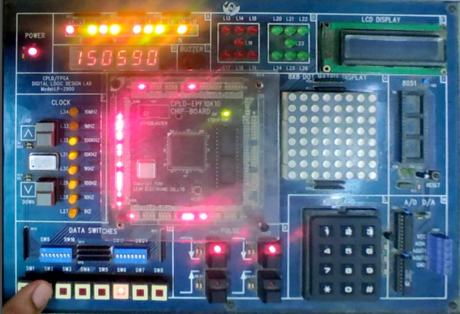
Sample Output
Money In : 100 (50Tk)
Fare : 90 Tk
Money Input : 105 Tk (100 Exceed LED on!)
Return : 15 Tk
Ticket Buy Completed LED ‘ON’

Slide 28
Thank you

